Slide 1

NeMo – Understanding the Product view
…and some C&P concept

Slide 2
Version | Date | Change description | Created/Modified by
1.0 | 02.12.2019 | Initial version | Rittick Banerjee
2.0 | 03.17.2019 | Card payment eco-system players Disputes Overview | Rittick Banerjee

Slide 3
Card Payment Eco-system players
Acquirer
Network
Issuer
Licensed institution to acquire and process card txns for merchants; provides various services to merchants to enable them process card txns – onboarding, infra provisioning (terminal, s/w), auth/clearing/settlement processing, handling disputes, statement, MIS
The network acts as a recognizable brand, ensures that transactions are processed correctly and set guidelines for member institutions, and mediate disputes between parties to transactions executed using their networks. They also set the merchant discount fee (MDR) charged during payment processing. (MDR compensate the payment eco-system players for their respective roles in the electronic payment process). As the intermediary, a network makes sure that, regardless of whether the card is used at a merchant or an ATM, the authorization and funds movement are properly directed to ensure money is appropriately distributed.
Institution that issue credit or debit card to card-members (CM) based on licensing agreement with network and participates in settlement of card txns; responsible for maintaining/servicing CM account and
Eg. Banks, credit unions, networks (Amex, Discover)
Eg. Non-banks (First Data, Elavon, Vantiv, Amex); Banks (Chase Paymentech, BofA)
Gateway
Issuer Processor
A payment gateway is a merchant service provided in an e-commerce txn to process card txn and authorize payment; key function of a gateway includes encryption, sending auth request & passing response to merchant, fraud detection.
Provides following services to issuers: account set up & maintenance, auth/settlement processing, statement generation, service inquiry, risk management, fraud reporting
Eg. Visa, MasterCard, American Express, Discover
Eg. First Data, TSYS
Eg. Paypal, Stripe, Square (US), CCAvenue, PayUmoney, Paytm (India)

Slide 4



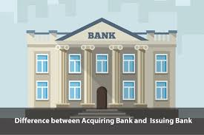



Payment Networks – Open and Closed loop
DEBIT Network
VISA/Interlink
MasterCard/Maestro
STAR
NYCE
PULSE
CREDIT Network
VISA
MasterCard
American Express
Discover
Scheme
OPEN loop
Network
Auth-matching/enrichment, Qualification/Interchange, Clearing
Settlement details for payment with approved interchange rate @ 1.58% + 0.10
CLOSED loop
Network
How is it different for AMEX?
Assessment fee: 0.11%
($98.32-$0.11)
= $98.21
($100-$1.68)
= $98.32
Acquirer
Issuer
Service fee
Statement
Sends batch file with financial & non-financial details
Acquirer Mark-up @.24% ($98.21-$0.24)
= $97.97
Monthly statement
$100
Clearing
& Settlement
Payment
Merchant Discount $1.68+$0.11+ $0.24 = $2.03
Merchant
Product
Consumer
Purchase
Merchant
Makes purchase of $100
Consumer
3-party payment model
4-party payment model
As Amex manages both the card-issuing activities of the business and the acquiring relationship with merchants, there is a “closed loop” in that they have direct access to
information at both ends of the card transaction, which distinguishes its integrated network from the bankcard networks like Visa and MasterCard.
Non-financial flow
Financial flow
Amex also supports acquiring through 3rd party processor (eg. First Data, Vantiv) for SMB merchants under its OptBlue program.
Trough Global Network Services (GNS) business, Amex establishes & maintains relationships with banks and other institutions around the world that issue cards and, in certain countries, acquire local merchants onto the Amex network

Slide 5
Few key concepts…
BIN (Bank identification number)
Amex MCC (Merchant Category code) * - determines industry type a merchants belongs to; primary decision making criteria for interchange rate
Network type | BIN range
Mastercard | 51-55, 2221-2720
Visa | 4
American Express | 34, 37
Discover | 6011, 622126-622925, 644-649, 65
RuPay | 6521
Few examples:
Industry type | MCC code | Description
Airlines | 4511 | Airlines and Air carriers
Amusement and Entertainment | 7832 | Motion picture theatre
 | 7911 | Dance Hall, studio
 | 7933 | Bowling alley
 | 7992 | Public golf course
Auto Rental | 7512 | Auto rental agency
Automobile | 5013 | Vehicle parts
 | 5511 | Car & Truck dealers
 | 5532 | Tire stores
 | 5551 | Boat dealers
Restaurants | 5811 | Caterers
 | 5812 | Eating places
 | 5813 | Bars, Night clubs
 | 5814 | Fast food
Use case 1: A Car dealer also sells tires and body parts; which MCC should it use?
Use case 2: A restaurant establishment has eatery in ground floor (“Connie’s steakhouse”) and pub (“Corner Pub”) in the 1st floor; which MCC should it use?
* Not an exhaustive list

Slide 6
Payment message ISO standard (1/2)
1100:
Authorization Request
ISO 8583
Auth Request response
1110:
MTI
Bitmap
Data elements
1101:
Auth Request repeat
1240:
1st presentment
ISO 8583 version
Message Class
Message function
Message origin
x1xx | Authorization
x2xx | Financial
x4xx | Reversal/Chargeback
x5xx | Reconciliation
x6xx | Admin msg
x7xx | Fee Collection
xx0x | Request
xx1x | Request response
xx2x | Advice
xx3x | Advice response
xx4x | Notification
xxx0 | Acquirer
xxx1 | Acquirer repeat
xxx2 | Issuer
xxx3 | Issuer repeat
ISO 8583 spec used by Amex: Global Credit Authorization Guide (GCAG)

Slide 7
Payment message ISO standard (2/2)
Few important data elements
DE 2 | PAN
DE 4 | Transaction amount
DE 5 | Settlement amount
DE 7 | Txn date and time
DE 9 | Conversion rate
DE 18 | MCC
DE 28, 29, 30, 31 | Txn & settlement fees
DE 24 | Function code
DE 22 | POS entry mode
ISO 8583
MTI
Bitmap
Data elements
Primary Bitmap : 8 bytes (64 bits) – DE 1-64
Secondary Bitmap: 8 bytes (64 bits) – DE 65-128
Subfield 1
Subfield 2
Primary Bitmap : 4210001102C04804
POS Terminal PAN Entry Mode
00 PAN entry mode unknown
01 PAN manual entry
03 PAN auto-entry via bar code reader
05 PAN auto-entry via ICC
06 PAN key entry
80 Chip card or chip-capable terminal was unable to process transaction using data on the chip, therefore, the PAN was entered via mag stripe
81 PAN manual entry via e-commerce
POS Terminal PIN Entry Mode
0 Unspecified or unknown
1 Terminal has PIN entry capability
2 Terminal does not have PIN entry capability
8 Terminal has PIN entry capability, but PIN pad is out of service
9 PIN verified by terminal device.
BYTE1 : 0100 0010 = 42x (field 2 and 7) BYTE2 : 0001 0000 = 10x (field 12) BYTE3 : 0000 0000 = 00x (no fields) BYTE4 : 0001 0001 = 11x (fields 28 and 32) BYTE5 : 0000 0010 = 02x (field 39) BYTE6 : 1100 0000 = C0x (fields 41 and 42) BYTE7 : 0100 1000 = 48x (fields 50 and 53) BYTE8 : 0000 0100 = 04x (field 62)

Slide 8
Payment Network – Key capability (1/2)
Capability | Definition
Client Set-up | Network must have the ability to capture, edit, delete and store information to enable Clients to operate on the Network. This would include client demographics, contract information, information to connect to/operate on any Network systems.
Client Servicing | The Network must have the ability to provide clients with interfaces that allow for inquiries, maintenance and reporting access to be distributed or accessed for purposes of serving their customers.
Certification | The network needs the ability to provide a capability to enable client certify for operation on the Network. Certification enables the client to maintain the quality, efficiency, and financial soundness of the American Express Global Network . Certification validates proper network messaging including authorization, settlement, addendum types, data collection and reporting messaging and payment technology , and capabilities such as EMV Chip Payments, Contactless or Mobile that add value to American Express Cards
Authorization Routing | The Network must have the ability to send mandatory and optional messages between clients (or their authorized processors or platforms) for real time Point of Sale (POS) and Automated Teller Machines(ATM) Transactions auth and responses
Validation and Transformation | The Network must have the ability to authenticate the sender of data, validate they are authorized to send specific data, and that the data sent is in an expected format. The network needs to be able to transform the data sent in to a format that is needed to process the data through the network platforms so that the data can be used for the purpose that it has been submitted.
Tokenization | The network will support Token Request and Token Requestors, Token process management, Token BIN management strategy, Token Domain management, Token Life Cycle management, and act as the Token Service Provider (TSP) for clients on the Network.

Slide 9
Payment Network – Key capability (2/2)
Capability | Definition
Clearing to Auth matching | Network will have the capability to perform matching authorized transactions with the message that has been submitted for payment. The authorization message shall be coupled with the message cleared for payment so that the transactions can be tracked through a full lifecycle.
Clearing | The network needs the ability to provide all of the necessary data for clients to clear and settle transactions through the Network. Clearing will route, edit and summarize the transactions that clients send to the Network. The Network will clear all transactions presented.
Pricing | The Network must be able to retrieve and calculate rates and fees as designated in contract terms and conditions at a transaction level, for issuer rates, networks (acquirer) rates and fees. The network must also have the capability to assess periodic fees to clients, based on the fee schedules listed in the Network Policy.
Settlement | The Network must have the ability and procedures necessary to calculate amounts owed to and from the Network and to affect subsequent funds exchange . The Network must be able to convert transactions from different currencies, calculate foreign exchange markups, and include any fees or rates attributable to the client within the settlement.
Disputes | The Network must provide clients the tools and processes necessary to support the facilitation of communications and liability shifts related to the dispute process. The includes but is not limited to User interfaces, systems logic to enforce Network policy, and reporting.
ATM | The Network must support ATM service providers. The Network must have the ability to process an ATM withdrawal message as an authorization and clearing message for clients who request this service.

Slide 10
Card Transaction life cycle stages
Message type | What it means | Sender | MTI | Function Code (DE24)
Authorization Request | Merchant/Acquirer sends Authorization requests to scheme, which gets passed to issuer. For Amex, Authorization request is sent to CAS. | Acquirer | 1100 | 100 – auth req; 180 – batch auth; 181/182 – prepaid card; 190 – account status check
Response for Authorization | Issuer responds to Authorization request with Authorization response code (Approved/Denied/Delayed auth etc) | Issuer | 1110 | As above
1st Presentment (1P) | Financial notification message originated by acquirer for clearing and settlement | Acquirer | 1240 | 200
Retrieval request | Issuer requests for additional documentation from acquirer; most common reasons – Satisfy CM enquiry Substantiate chargeback Support legal/fraud investigation | Issuer | 1642 | 603
Fulfillment | Acquirer sends supporting documents to issuer; this can include receipts, invoices, tracking numbers, shipment information and any other data that might have on the transaction | Acquirer | 1640 | As above
First Chargeback | Raised by issuer to debit merchant’s account based on consumer disputes or other processing errors/fraud identified by issuer; should be filed within 120 days of ntw processing date | Issuer | 1442 | 450 (full amount) 453 (partial amount)
2nd Presentment (2P) | The merchant re-presents the transaction, accompanied by supporting evidence that contradicts the cardholder’s claim. A second presentment must be for the total chargeback amount or a lesser amount. | Acquirer | 1240 | 205 (full amount) 282 (Partial amount)
Final Chargeback | The issuer received insufficient or incomplete documentation in 2P, rejects the 2nd presentment and raises a final chargeback to acquirer | Issuer | 1442 | 451 (full amount) 454 (partial amount)
Fee Collection | Additional Miscellaneous fees charged by acquirer or issuer (eg. The issuer may collect a USD 25 handling fee when processing a chargeback by submitting a Fee coln message) | Acquirer/ Issuer | 1740 | 700/ 780/ 781/ 782
With financial impact

Slide 11
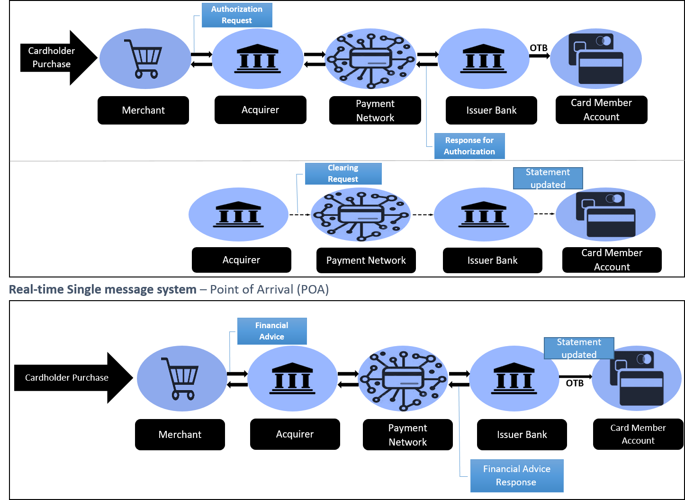
Driving Real-time Payment with NeMo
Dual message system – Point Of Departure (POD)
ISO message type
Authorization Request
1100
Response for Authorization
1110
Clearing Request
1240
Financial Advice
1220
Financial Advise Response
1230

Slide 12
American Express Card Acceptance Support Services
American Express OptBlue Program | Designed to increase acceptance of Cards among small Merchants by offering an integrated service and pricing through certain eligible third party Acquirers and payment processing companies.
Authorization Amount Adjustment | It can be used by any Merchant, Third Party Processor or Vendor that supports Automated Fuel Dispensers. This functionality allows for the release of held funds due to the actual sale amount being less than the original authorized amount. The Authorization Adjustment Financial Transaction Advice Request/Response (1220/1230) message is mandatory for Third Party Processors, Payment Aggregators, and Vendors that support the oil industry.
Batch Authorizations | A Merchant who uses the batch authorization service can transmit authorization request files containing multiple authorization request transactions periodically during a day or at the end of the business day. All authorization response transactions are batched into files and returned.
Chip Card Authorizations (ICC) | Two types of Chip Cards are issued by American Express: • AEIPS — A Contact Chip Card is physically inserted into a Card Reader to enable it to communicate with the Terminal. The American Express contact solution is called AEIPS (American Express ICC Payment Specifications). • Expresspay — A Contactless Chip Card uses radio frequency technology to communicate with the Terminal, and the card does not need to be inserted into a reader. The American Express contactless solution is called Expresspay.
Digital Wallet Payments | This service allows Merchants to accept Digital Wallet transactions which provide Cardmembers a quick and flexible way to pay in store and within Mobile Applications (App) via various devices that Cardmembers frequently use.
Online Authorizations | A Merchant who uses the online authorization service can transmit an authorization request and receive an authorization response, all in one individual session.
Prepaid Card Authorizations | This service allows a Merchant to accept and process an authorization request for American Express Prepaid Cards.
Recurring Billing and Standing Authorization | Recurring Billing transactions include periodic billings for regularly scheduled charges while Standing Authorization allows a Merchant to automatically charge a Cardmember’s American Express Card.
Zero Value Account Verification (ZVAV) | This service allows a Merchant to validate a Card’s status by utilizing a combination of specific processing codes and a zero transaction amount.
Other Authorization Services | A Merchant may process other financial transaction cards, as well as American Express Travelers Cheque authorizations.

Slide 13
Merchant Servicing
Disputes

Slide 14

Disputes life-cycle
Disputes Message Types – Retrieval, Chargeback, Good Faith, Arbitration
Acquirer
Network
Issuer
1
2
2
Card member
3A
SE / Merchant
4
4
3B
6A
5
5
6B
7
7
8
8
9
9
+
If acquirer can’t send fulfillment, would have very limited 2P right
1
Raise Disputes
3A
Send RR to SE
5
1st chargeback (1CB)
7
2nd presentment (2P)
3A
Responds with Fulfillment notification
6A
Accepts 1CB* or Disputes with supporting documents
8
Final chargeback
2
Retrieval request (RR)
*
If 1CB is accepted, no further action is required
4
Forward fulfillment to issuer ⁺
6B
Accepts 1CB or Disputes with supporting documents
9
Arbitration

Slide 15
Disputes Reasons – 4 key reason types
Case opened
Yes
Upfront chargeback
Sufficient information to support chargeback
No
Inquiry / Retrieval
Sufficient information to support chargeback
FOUR categories of Disputes *
Authorization
Customer Disputes
provides the Issuer rights to transfer liability to an Acquirer when there are discrepancies between the Network's Authorization policies and the manner in which Authorization was carried out
provide the Issuer rights to transfer liability to an Acquirer where the Cardmember has raised issues that either cause the Cardmember to withhold payment for such Transactions or claim that Credit is due to the Cardmember's Account
ISO 4521 – Invalid Auth
ISO 4513 Credit Not present
ISO 4515 Paid By other means
ISO 4544 Cancellation of recurring goods/services
ISO 4553 Defective merchandise
ISO 4554 Goods/Services Not Received or Only Partially Received
ISO 4750 Car rental charge non qualified
Fraud
Provides the Issuer with rights to transfer liability to an Acquirer according to the specific conditions of the applicable Chargeback rule, and after reporting the incident of Confirmed Fraud to AEGNS
ISO 4527 Missing Imprint
ISO 4534 Multiple ROC
ISO 4540 Card Not Present
ISO 4755 No valid Auth
ISO 4763 Fraud full recourse
Processing errors
provide the Issuer rights to transfer liability to an Acquirer when errors occur at the POS or at the Acquirer's data processing center
ISO 4523 Unassigned Card Number
ISO 4530 Processing error chargeback
P05 Incorrect Charge Amount
ISO 4536 Late Submission
Merchant has 20 days to respond to an inquiry and 20 days to respond to a chargeback
* Not an exhaustive list

Slide 16
Dispute Fees
Disputes type | Fee | Description
Retrieval | $2.00 | Charged to the party who raises
Fulfillment | $0.00 | No fee
1st Chargeback | $3.00 | Charged to the party who raises
2nd presentment | $3.00 | Charged to the party who raises
Final CB | $0.00 | No fee
Message reject fee | $5.00 | Assessed if the Disputes is rejected by network
Good Faith | Processing fee ($10) | Charged to both participants
Good Faith | Non-response fee ($100) | Participant that doesn’t respond to Good Faith
Arbitration | Filing fee ($150) | Assessed on all submitted filing; filing fee on accepted filing is collected from responsible party
Arbitration | Penalty fee ($100) | Charged against violation of network policy
Arbitration | Review fee ($250) | Assessed 30 days from the date arbitration committee receives filing; is collected from responsible party post resolution

Slide 17

Disputes Flow – POD
Fraudnet:
Allows GNS partners to manage and communicate fraud information
Fraud type API – provide fraud type indicator to support fraud chargeback processing
High risk API – provides merchant high-risk code /non-compliance indicator support safekey/CB txns
User auth details
GNSWeb
Partner attribute (Org, feature)
Acquirer
Issuer
PSU
Fraud, high-risk, non-compliance indicator
GDM (Global Disputes Management):
Disputes Case management system built on Pega; resides outside GNS. GDM sends/receives documents to/from OpsNet via IVU (Image view utility). For OpnNet -> GDM doc flow, an ETL process runs for batch upload
Fraudnet
Opsnet
GC&S
Import/Export of Disputes and 1P
Disputes txns
Business rules
BRMS
Daily Accounting feed
TLCM
GCM
(EU acquirer)
CHARMS (Chargeback accounting and routing system):
Once 1CB is raised, CHARMs makes entry in Acquirer chargeback ledger to debit acquirer and credit issuer chargeback ledger, in order to shift liability from issuer to acquirer
CHARMs
Supporting documents for prop merchants
GDM
Txn flow
Data flow
Document flow
Accounting flow

Slide 18
OpsNet
OpsNet is a web-based business tool that supports Disputes processing including Good Faith and Arbitration
Dispute documents
Dispute documents
Attach document
Enter Comment
Opsnet
user portal
Opsnet doc routing
Opsnet Inbox
sender
receiver
Document
only
Partner messaging system
Dispute txn
GC&S
Dispute txn
Partner messaging system
sender
receiver
DAR / DAF
Attach document
Enter Comment
Select Dispute reason code
Dispute Amount
Dispute description
Dispute documents
Opsnet doc routing
Dispute documents
Opsnet Inbox
Full
functionality
Opsnet
user portal
sender
Dispute txn
GC&S
Dispute txn
receiver
DAR / DAF
Partners can manage OpsNet INOBX :
Filtering criteria
Org
Message type (RR, FF, 1CB etc)
Disputes type (sent/received)
Reason code
Search criteria
TID
CM number
SE ID

Slide 19
Disputes flow - POA
NeMo UI
Doc Service
Core Service
Rule Service
Dispute Core
Drools
GFR
Clearing and Settlement
SOR (1P)
Pricing
Settlement
Accounting
Disputes Servicing
Create
Dispute
GetSearch
Dispute
Update
Dispute
Get
Reason
Codes
Get
DisputesPricing
Disputes
Rules
Rules
Administra- tion
Stream
Documents
Anti Virus
Scanning
Store
Documents
Get
Documents
Document
Processing
Compression
Image
Processing
Document
Hashing
Document
Cache
Approval
Workflow

Slide 20
NeMo RTPE – Architecture view
Client set up
Pricing model and currency relationship for institution
Resiliency – config, secrets
CSU
Data Management
File Watcher
RTPE*
Kafka
Common service
Message translator
Message validation
Business validation
Detokenization
Bin service
Currency conversion
Auth service
Merchant validation
Address verification
TID generation
Merchant/Fraud risk
Crypto validation
Additional Data
Internet/ Phone Data
Airline Data
Shipping Data
File Reader
Prop merchant/ Opt Blue
Issuer
TCP/IP
Auth request
1100 message
Protobuf
Proxy
Transaction router
Gateway
NOS (Orchestrator) – Configuration + Validation + Workflow
GNS Acquirer
TCP/IP
EDC (Single message)
Validation
Routing
Clearing service
Accounting
Auth match
Msg transformation for addenda
Data enrichment (thru CSU/CRD)
Rules extraction
Pricing
DAP
Shared components
Rules mgmt
CRD
Logging framework
Crypto as a service
GCAG format
GAN AUTH
Key Management
Auth response
1110 message
Create/Update Disputes
Rules
Reason Codes
Document Management
Disputes Pricing
Disputes
ENVOY
Read/Write
Transaction SOR
* Real-time Payment Engine

Slide 21
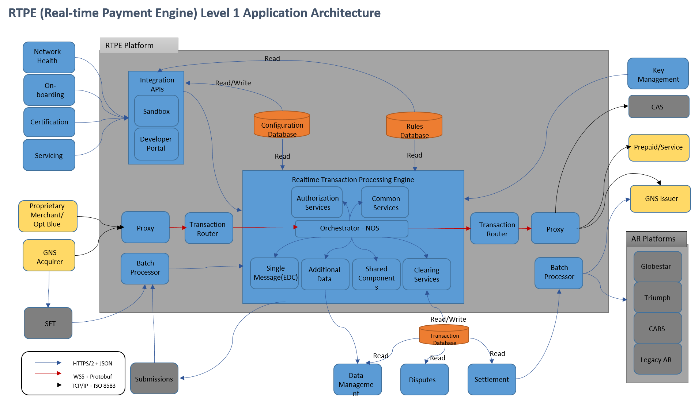

Slide 22
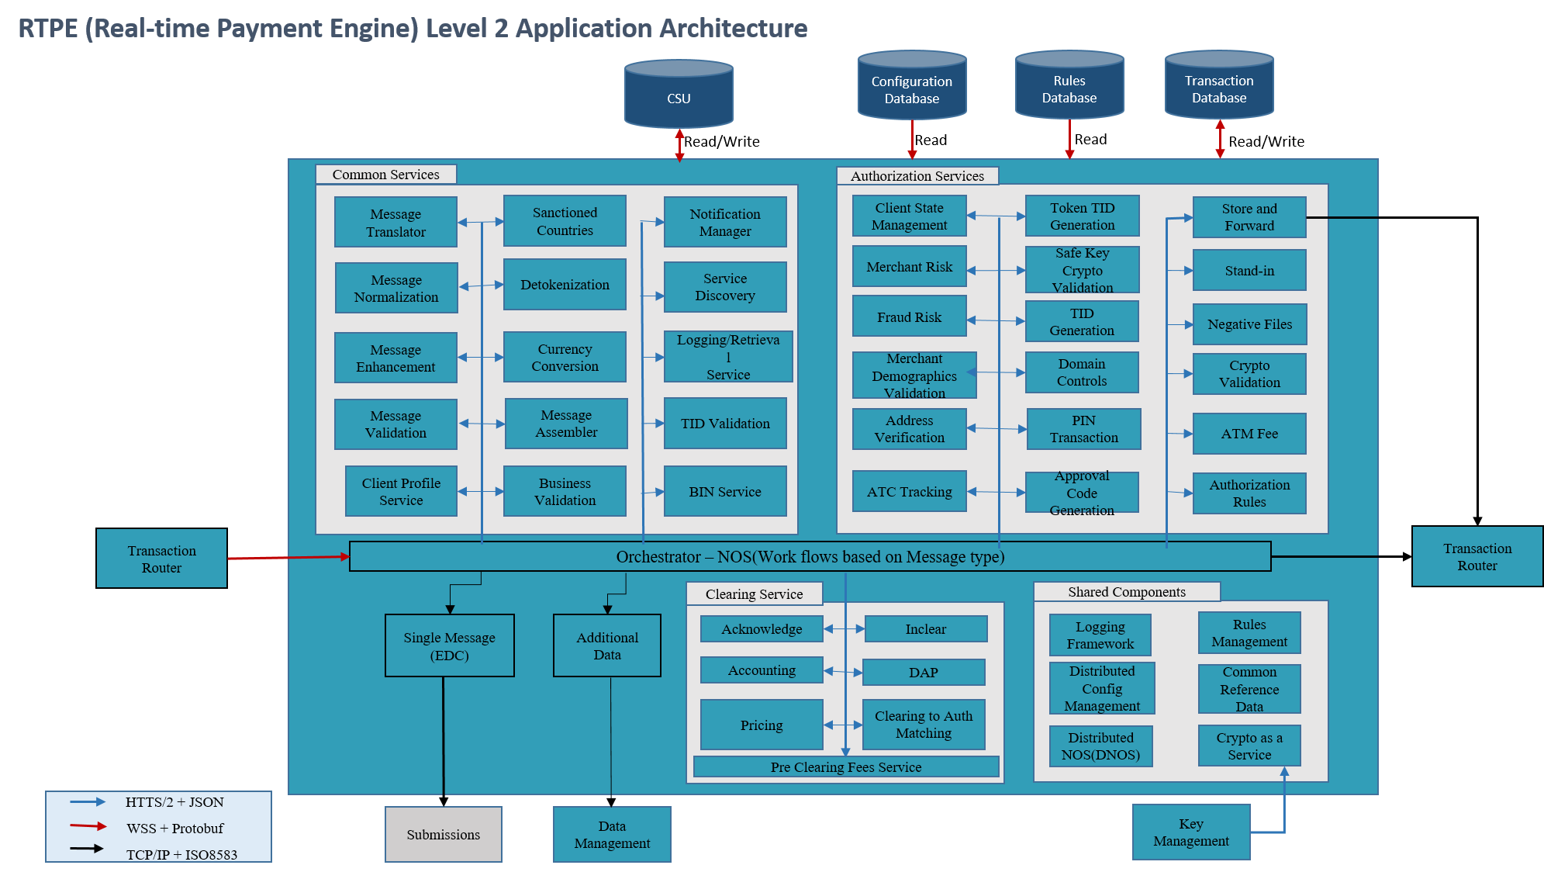

Slide 23
Different Fee /pricing rates in Amex
Fee/Rate type | Description
Merchant Discount Fee | Amount American Express charged a merchant for accepting Amex card
Standard rate | NeMO can determine basic issuer and Network rates based on local or foreign status. Local is calculated by MCC and industry segment. Transactions are considered local when se country code and issuer domicile country code are the same. MCC and Industry pricing are calculated based on contract in CSU.
Regional rate | Transactions are considered regional, when a region has been established over a few countries to designate the countries in a specific region (eg. Netherlands), and regional rates would be applied.
Fx Markup | FX Markup is applied when presentment currency and settlement currency are not the same; Fx markup is assessed for settlement and billing
Cross-border Fee | Cross-border Fee is applied where presentment and settlement currencies are same, but merchant and card issuer countries are not the same. Cross-border Fee would be suppressed, if CSU indicates so
Non-swiped txn fee | A fee applied to any Charge for which we did not receive both (i) the full Magnetic Stripe or Chip Card Data from the Card/Devices, and (ii) the Magnetic Stripe or Chip Card Data indicator.
Cash disbursement Fee | Nemo will determine cash disbursement rates for MCC 6010, processing code 014008, and calculate the cash disbursement fees based on PSU input for industry code 6010. This rate is assessed and paid to the acquirer and paid from the issuer , opposite to other network and issuer fees

Slide 24

A high level view of Pricing
Transaction Processing
Network Interactive Portal
Rates data from CSU includes FX Markup, Cross Border Rate, Interchange Rate and any applicable taxes
CLEARING TRANSACTION WORKFLOW
CSU DATA SERVICES
Validation and Enrichment
Enrichment Data
PARTNER MODEL ASSOCIATION & RATES
Business Rules Execution
Partner Setup
CLIENT DATA AND RATES REPOSITORY
Client
Setup
Pricing Model Selection (Standard/Brazil/DINRP/PERU/TRILOGY/ACQ LOCAL/ACQ FOREIGN)
Pricing
Pricing Model and Rates
Pricing Model Execution
Rates Entry for selected Pricing Model
Pricing Model Setup
RULES DEFINITION AND GOVERNANCE UI
Settlement
Currency Relationships
Create/Update/Delete a rule flow
CLEARING AND SETTLEMENT RULES REPOSITORY
Calculation Rules Execution
Create/Update/Delete rule
RULES SERVICE
Accounting
In-clear Data
Rule Governance
Accounting Rules Execution
Network Interactive and CSU
Clearing and Settlement

Slide 25
Workflow for Acquirer and Issuer Pricing
Start
Uses AIN/IIN*, AIN/IIN region, industry segment, pricing method
Apply MCC rate
Uses AIN/IIN, industry segment, pricing method, role type
If 1P Txn
A
END
No
Yes
Apply Regional rate
Yes
If Rate found
Change Pricing Method to “MS”
Get Pricing method
No
Get rate from industry pricing table
Yes
B
A
No
If Rate found
No
If Txn is domestic
Get rate from Regional pricing table
Yes
Get rate from MCC pricing table
If Rate found
If pricing Method = “MS”
No
No
Uses org, role type, AIN/IIN, pricing method, MCC
Yes
Yes
If pricing Method = “MS”
Yes
Get rate from industry pricing table
Apply Industry pricing rate
Apply Industry pricing rate
Fail the process
No
Change Pricing Method to “MS”
B
* AIN – for acquirer pricing; IIN – for Issuer pricing

Slide 26
CSU interface to determine right Pricing model
Pricing model is determined based on CSU set up
Pricing Method | Description
MS | MAGNETIC STRIPE
MSP | MAGNETIC STRIPE PIN
SC | SMART CARD
SCP | SMART CARD PIN
Establish Hierarchy for MCC pricing
MCC Pricing applies only to local transactions
Both Partners must be enrolled to recieve MCC pricing .
Both issuers and acquirers must be partcipating in MCC pricing for MCCCpricing to apply to either - if one is not enrolled, then industry rate pricing will apply to both.
Scenarios concerning MCC Rates :
Scenario 1
Rate is available for a given partner in the MCC rate table
In this case the pricing method is checked against the MCC pricing table and the corresponding acquirer/issuer rates are applied.
Scenario 2
Rate is not available for a given partner in the MCC rate table
In this case the pricing method is checked against the industry specific rate table and the corresponding acquirer/issuer rates are fetched.
Scenario 3
Rate is not available for a given partner in the MCC rate table and industry specific rate table. In this case the pricing method is defaulted to ‘Magnetic Stripe’ and the process follows scenario one or two based on rate availability in MCC rate table to fetch the corresponding rate
Scenario 4
Rate is not available in the MCC rate table and industry specific PSU rate table for a given partner whose pricing method defaulted to ‘Magnetic stripe’ . The program is terminated and the transaction is not processed further.
Role Type | Description
AC | Acquirer
AP | Acquirer Processor
IS | Issuer
IP | Issuer Processor
Currency type | Description
Presentment currency | Currency code in which transaction is presented to Network
Settlement currency | Currency code in which institution is getting settled
Card-member billing currency | Currency code in which billing will be performed

Slide 27
Appendix
Terminology | Description
ATR | Amex Transaction Router
CAS | Credit Authorization System
EDC | Electronic Data Capture
EMV | Euro pay MasterCard Visa
GAN | Global Authorization Network
GCAG | Global Credit Authorization Guide
GEDC | Global Electronic Data Capture
GHDC | Global Host Data Capture
GPK | GAN Public Key is an RSA public key for the GAN EDC application. It is packaged with terminal application and is available for use during initialization
IAC | Initial Authorization Code is a initialization code which is uniquely supplied to a terminal during initialization
ICC | Integrated Chip Card
MTI | Message Type Identifier
PAN | Primary Account Number
ROC | Record of Charges
RRN | Retrieval Reference Number
SOC | Summary of Charges
STAN | System Trace Audit Number
TID | Transaction Identifier

Slide 28
Thank You

